Slide 1
Thesis Proposal Idea
Genetic algorithm to train a batbot to hover
Anuar santoyo alum
2023/02/20

Slide 2
TABLE OF CONTENT
Problem Statement
General Optimization Workflow
Static Hovering Test
Dynamic Hovering Test
* MORE DETAILED INFORMATION

Slide 3
Problem Statement
Goal: Batbot to achieve stable hovering.
Problem: Complex control strategy as flapping wings are much more complex compared to for example a quadcopter.
Solution: Design a testing environment were, by means of a genetic algorithm, the Batbot can safely learn by itself the necessary controls to achieve hovering.

Slide 4


PROBLEM Statement - How can this be achieved?
Problem: Training might need a lot of repetitions which is difficult when training in real world and not in simulation.
Solution: 2 Step Training( 1st Static, 2nd Dynamic)
Static Hovering Test
Dynamic Hovering Test
Batbot fixed to a point to learn basic movement needed to hover.
Batbot allowed to fly without attachments to train control system based on results of static hovering test.

Slide 5

General optimization WORKFLOW
Computer running CMA
* WHY CMA?
1st Step: Evolutionary algorithm Covariance Matrix Adaptation (CMA) proposes n solutions (solution varies from test to test)
2nd Step: n Tests are carried out in the test bench and using the sensors a score is calculated for each test
n Scores
n Solutions
3rd Step: Scores of the tests are given back to the computer so that the CMA can use information to propose other n solutions
n Tests in Testbench

Slide 6
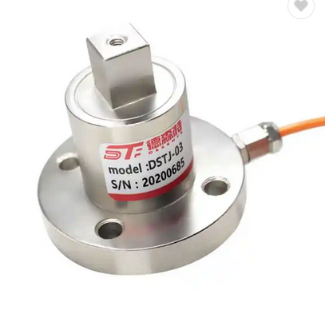

Static hovering test
IMPORTANT: Result of this test only gives direct command to motors (no controlling yet) to obtain approximate power needed in each motor to hover in perfect conditions.
NOT ABLE TO AUTONOMOUSLY FLY YET
Micro-controller that enables wireless communication:
MultiAxial Force Torque Sensor
-ESP8266
-Arduino UNO WiFi Rev.2
-Raspberry Pi Zero 2 W
-….
* SENSOR POSITION ON ROBOT NEEDS DYNAMICS ANALYSIS AND CENTER OF MASS
Solution:
ONLY Motor Commands
*HOW IS SCORE CALCULATED
Scores of Tests

Slide 7
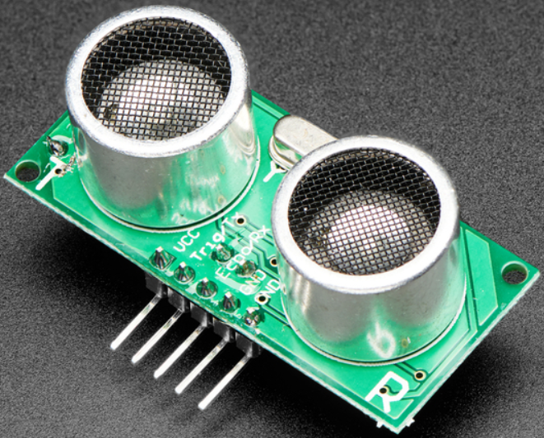
dYNAMIC hovering test (free flight enabled)
Solution:
Controling System that uses BatBot accelerometer as input and controls Batbots motors (not just direct motor command, like in static test)
String
Force Sensor
Solutions
Position Sensor
*Extreme simplification, several ideas for position sensor: Array of US sensor, Camera and OpenCV Python,, OptiTrack alternative
Scores

Slide 8
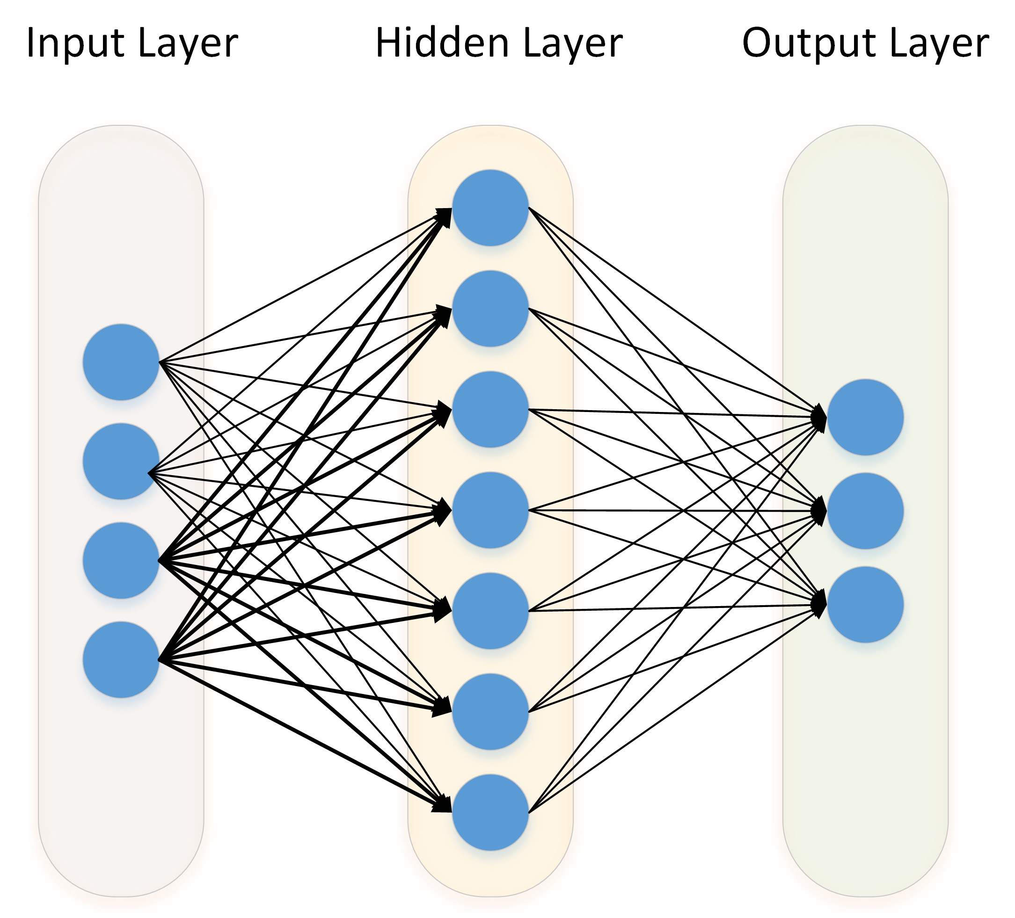
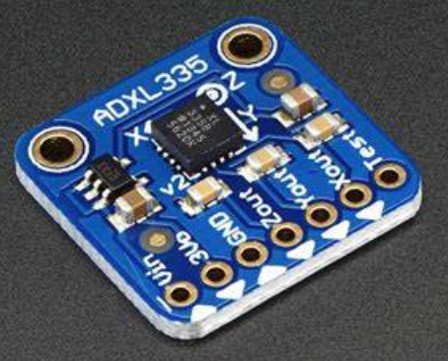
ControlLing system optimization
Batbot Motors
Accelerometer
*Traditional controlling methods can also be optimized using evolutionary algorithm
Neural Network

Slide 9
Summary
Static Hovering Test: Optimizes direct motor command to approximate hovering
Dynamic Hovering Test: Uses results of Static Hovering Test as starting point to optimize controlling system to hover.

Slide 10
Thank you!

